Slide 1

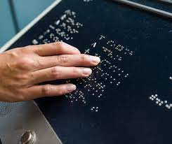
YEAR
2023-2024
Website for
visually impaired
.
PROJECT BY:
Adarshdeep Gupta
Shriniwas Ahirrao

Slide 2
01
Problem Definition
Government documents are not accessible to people with visual impairments.
Millions of visually impaired people struggle with inaccessible government documents.
Impacts: Difficulty accessing benefits, political participation, and understanding legal rights
NEXT

Slide 3
02
Solution
Website using OCR to scan and convert documents into text.
Translation to Braille and printing.
The website will also provide a number of other features to make government documents more accessible, such as:
Audio recordings of the documents
Zooming capabilities
Text-to-speech capabilities
NEXT

Slide 4
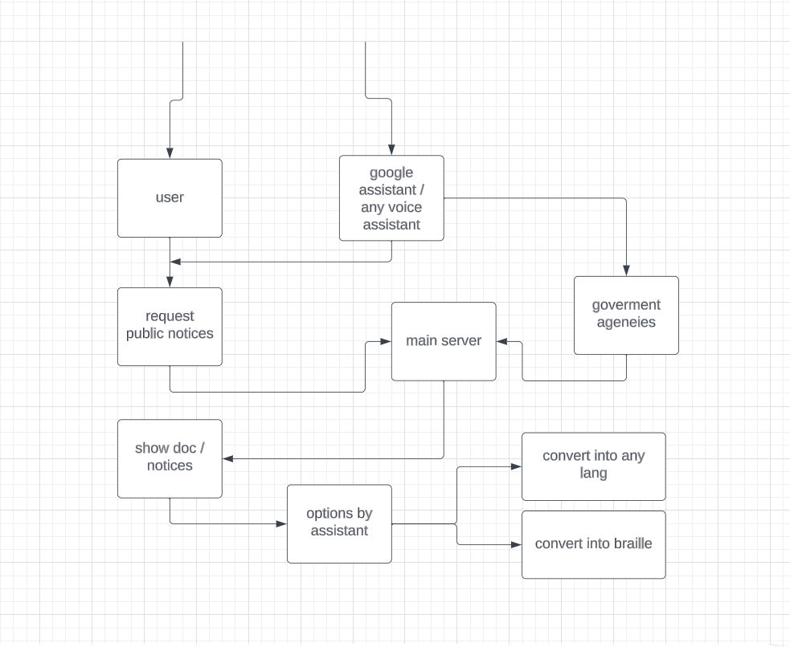
NEXT

Slide 5
03
Tech Stack
JavaScript / python
MD5
Cloud hosting
Website:
User interface for blind people
Database of government documents
Search engine
NEXT

Slide 6
04
Uniqueness
It is the first website to provide a comprehensive solution to the problem of making government documents accessible to blind people.
It uses cutting-edge technology to provide a high-quality experience for users.
It is designed to be user-friendly and accessible to people with all levels of visual impairment.
NEXT

Slide 7
05
Architecture of Ideaeness
The website will be divided into two main parts:
The OCR engine: This will scan government documents and convert them into text.
The braille generator: This will convert the text into braille and print it out.
The website will also have a number of other features, such as:
A user interface for blind people
A database of government documents
A search engine
NEXT

Slide 8
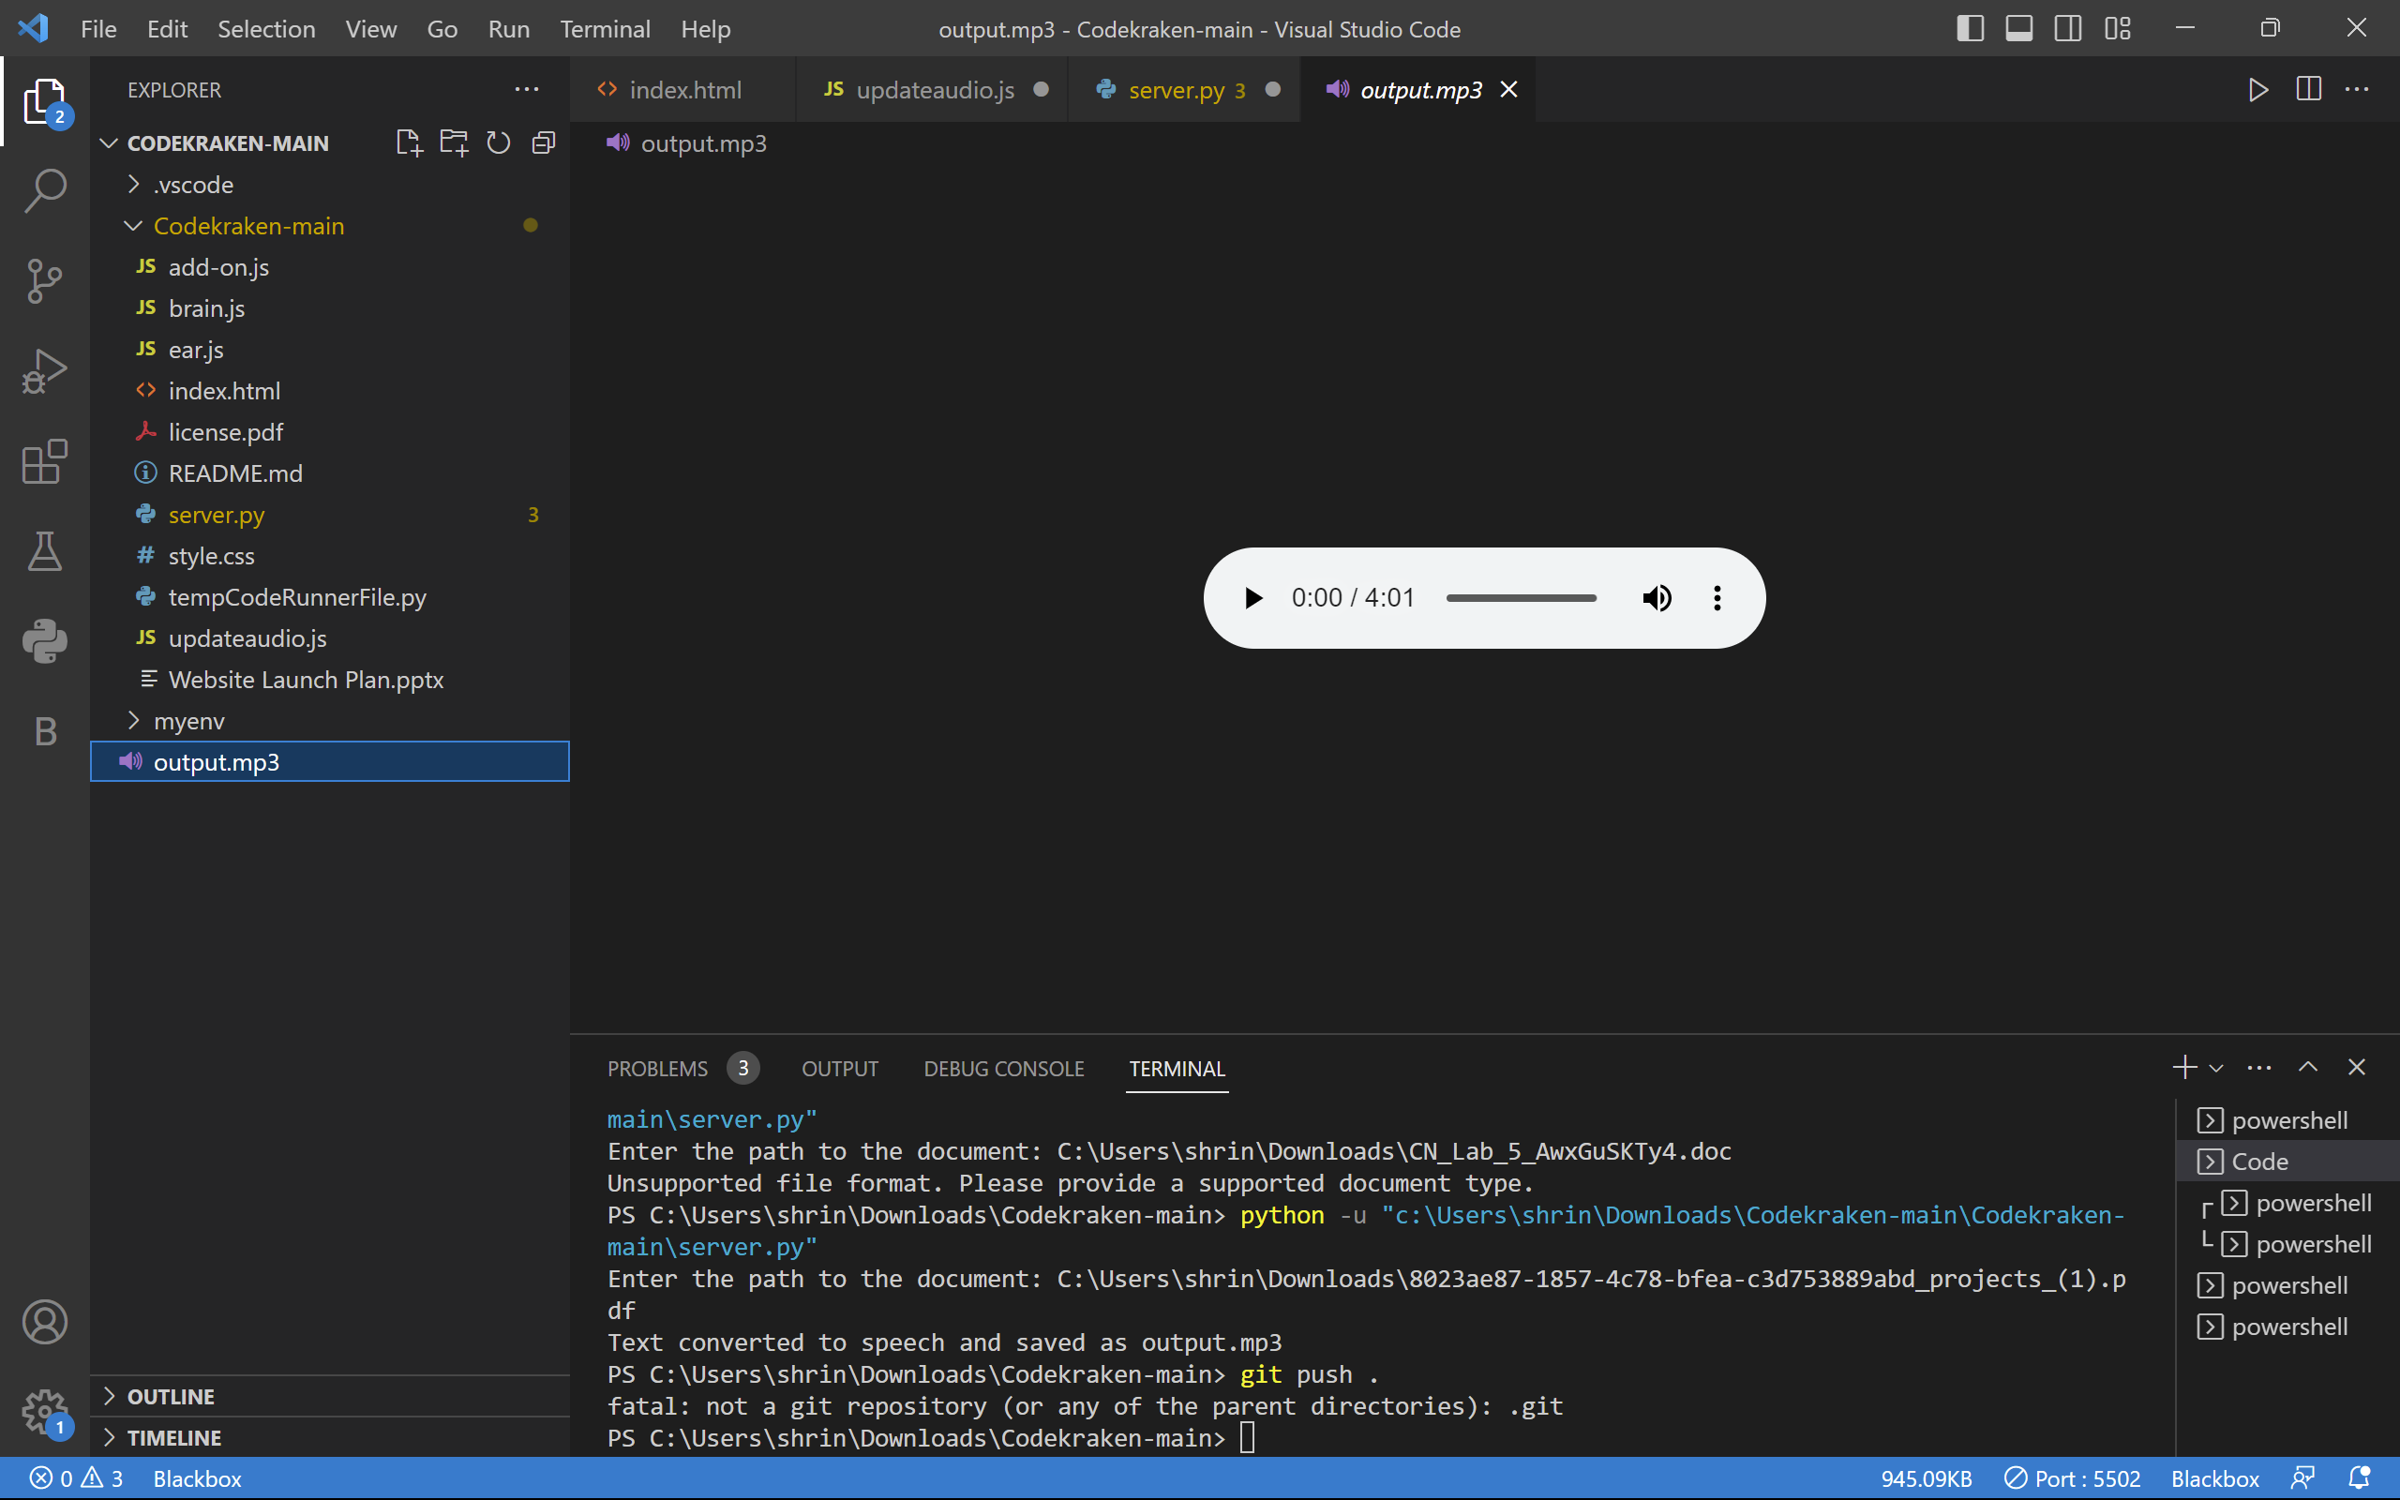
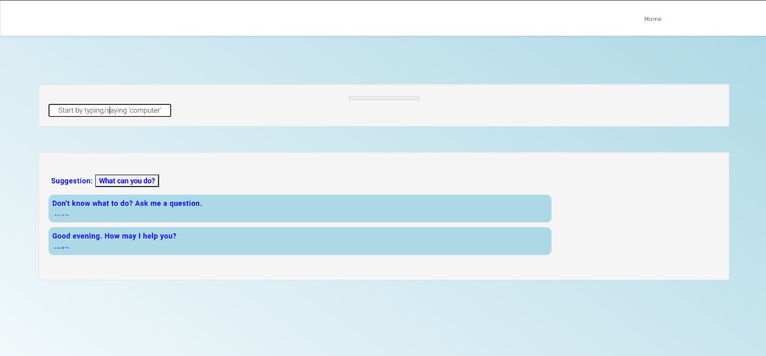
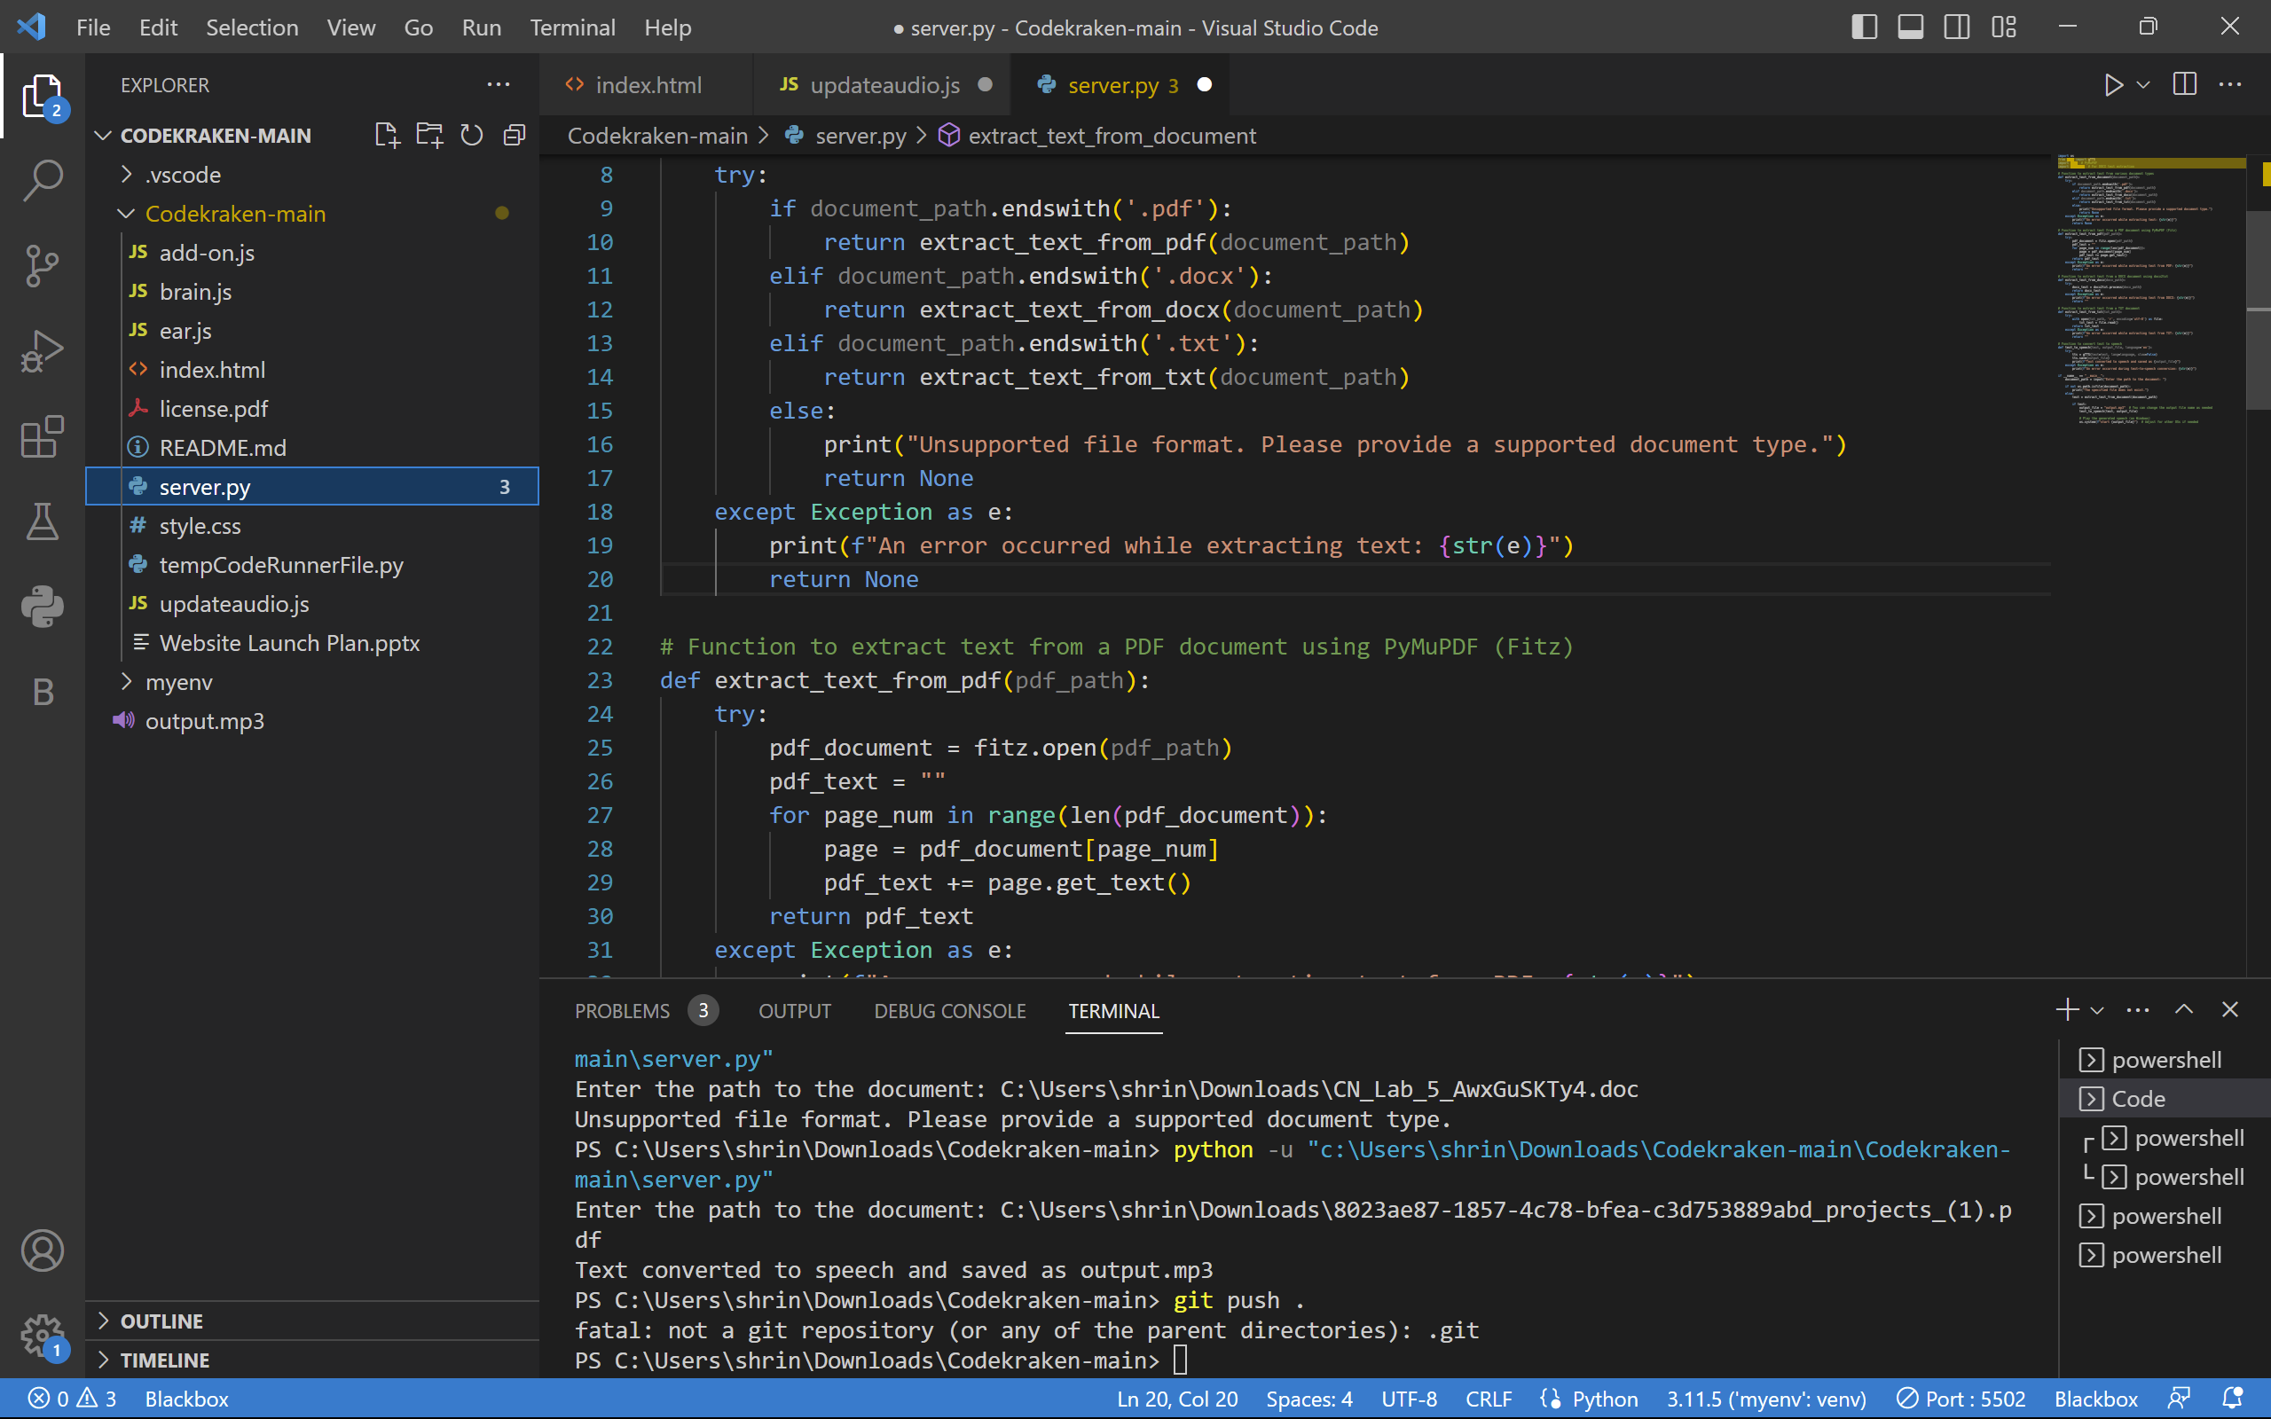
Snippets
NEXT

